Slide 1
Hybrid-PBL: Getting to Grips
Monday 15th July 2013
London South Bank University

Slide 2
Outline Of Session...
Using ICT and Social Media in Hybrid PBL
Supporting the Process: Exercises to Help Group Dynamics
PBL Assessment and Peer Assessment
Coping with Diversity
Interactive session, our experience and findings, your experience, thoughts and questions...

Slide 3
Potential Issues With Problem-based Group Work
Resource intensive
Group members failing to turn up
Lack of preparation by students
Dominating students
‘Passenger’ students
Conflicts within groups
Tutors fail to manage group problems
New way of working/groups having difficulty getting started
Disciplinary and cultural differences
PBL training for facilitators and students
Content coverage: knowledge v skills

Slide 4
1) Using ICT And Social Media In Hybrid-pbl Why Is It Important and How Has It Been Used?
Graduate Attributes
Scaling-Up PBL
Flexible and online learning
Information and technological literacy
21st Century learning – e.g. social media
Traditional PBL is resource and time intensive
‘Hybrid-PBL’ = Traditional PBL + some adaptations
Less timetabled face-to-face module meeting hours & less f-2-f facilitator input with individual groups
Enables PBL-style teaching with larger student cohorts
Notes:
Two main reasons why ICT is important to our approach. The first relates to graduate attributes. Ensuring that students are technologically, digitally and information literate is really important for graduates in the 21st Century. Many universities put strong emphasis on online learning and many employers now expect graduates to be able to communicate and work using varying technologies and social media. The second relates to the resource-intensive nature of traditional PBL. Substituting some of the face-to-face PBL with online PBL. Online group working frees up class time to be used for the most important PBL tasks and also serves to reinforce the learning that goes on in class. The mixture of online and face-to-face methods is our hybrid way of delivering PBL. ICT and social media make PBL a more feasible and accessible mode of teaching for larger student cohorts... How has online learning been used – 2 main ways.

Slide 5
Virtual Delivery Of Module Content
During traditional PBL, module content is not ‘delivered’ in the same way as in lectures
What if students don’t learn everything they need to know?
PBL emphasises skills not just content
There may be times when certain levels of content knowledge are vital, e.g. examinations
One approach...
VIRTUAL CONTENT DELIVERY
THE IDEA
Some traditional module content is delivered online, as well as carrying out PBL work in class
Students learn core background topics and concepts online before or after PBL classes
Brings students from different disciplinary backgrounds to a more level playing field
PowerPoint Slides
Podcasts
Screencasts
Notes:
Module content is built around problem scenarios and tasks. Its not spoonfed. Tackle more complex issues in class, critical debates, allows more time to work on group projects in class time. Video and audio files enable students to watch and listen to the learning materials over and over, on different media devices, are very accessible and can be disseminated to students in many ways.

Slide 6
Issues For Consideration When Using Virtual Content Delivery In Hybrid-pbl
Giving too much information away
Time required to develop virtual resources
Length of podcasts and screencasts
Ensuring that students are watching/listening to podcasts/screencasts as instructed
Keeping materials engaging
“The information is clear and useful. I can download the podcast anytime and listen to it wherever I want”.
“Listening to the podcasts was very convenient as you could do so in your own time. I found them a useful way of receiving a good overview of a topic that then allowed you to do your own personal research afterwards when you found an aspect interesting”.

Slide 7
Idea 1 - Weekly activities linked to slides and podcasts. Activities feed into next class session.

Slide 8
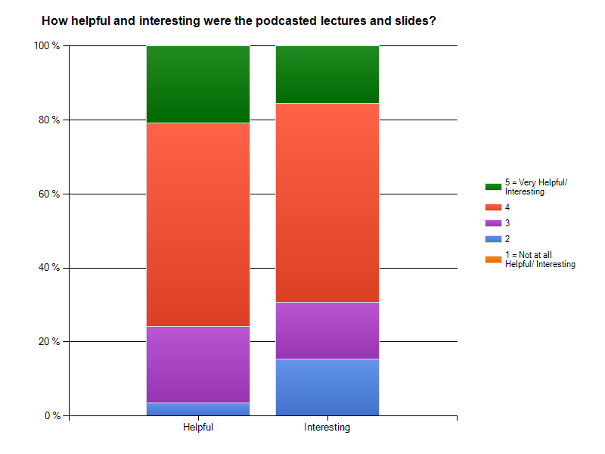
Your experience, thoughts, questions?
Keele Module 2013

Slide 9
Online Student Communication, Collaboration And Facilitation
How do we foster productive group working environments between PBL groups who have less time, space and privacy to meet each week?
When group-facilitator contact time is more limited, how do facilitators go about providing support to groups?
Virtual PBL
Online Student Communication and Collaboration - chatting, sharing ideas, posting research, discussing assessments, sharing websites, producing group work together online, e.g. using a wiki, through file sharing
Online Facilitation - facilitating group process and PBL learning environment; monitoring and steering student discussions; providing guidance and case study data; helping to resolve group conflicts; providing group support and answering questions.
PBL facilitator is part of online PBL-group discussion space
Performs all the same functions but online

Slide 10
Types Of Online Student Communication & Collaboration
Synchronous Tools
Asynchronous Tools
All members online and communicating at the same time
Instant text messaging or ‘chat’, e.g. Skype, Facebook, msn, VLE
Group video calling, e.g. Skype
Web conferencing/webinars using Elluminate Live!, Gotomeeting
-------------------------------------------------
Pro: immediate nature useful for quick decision making & clarification
Con: coordinating members to meet, technical issues
Members do not all have to be online at the same time
Members leave messages that others pick up and respond to
Discussion boards/forums/threads, e.g. VLE, Facebook groups
Group email, Google docs and wikis
----------------------------------------------------
Pro: well suited for gathering information, research and opinions, allows members to contribute when convenient & research responses
Con: slower pace means more time to reach conclusions

Slide 11
The Virtual Pbl Approach
Virtual Learning Environment
Online VLE discussion boards
Set minimum amount of words/entries per week
VLE not a daily online habit
Interaction more coerced than fluid
Hard to actively manage groups when students don’t use tools regularly
The following year students were given the option of using VLE or Facebook discussion groups...
Facebook
Facilitator member of Facebook groups
No need for becoming ‘friends’
Oversees all group communication, easy interaction, regular contact
Identify groups needing support
Students said they liked being ‘watched over’, it was a ‘safe environment’, and the level of facilitation was ‘just right’
Students use Facebook daily for social networking
One facilitator can effectively manage several groups
“I liked the way we could easily communicate with the facilitator via Facebook as this meant we got quick and effective replies to any questions we had.”

Slide 12
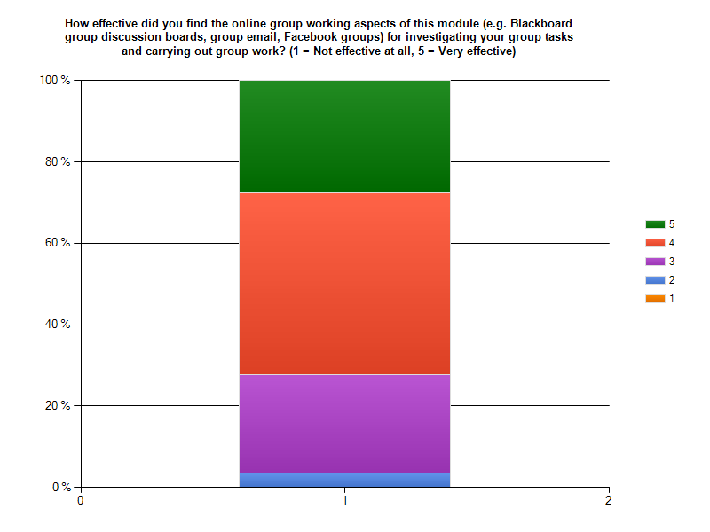
Keele Module 2013

Slide 13
The power of facebook…
Preference for tools otherwise used for social networking, e.g. Facebook, Skype, email, Whatsapp
“Blackboard proved to be more difficult for communicating, so my group switched to Facebook. Once we used Facebook we all found communicating quick and effective”.
“The functions are rigid and limited compared to other online platforms”.
Q7. My group used additional online tools (e.g. Facebook) to collaborate online. (14/15 agree)
“All of our group meetings, group works and group documents are planned and shared by Facebook. It is convenient and updated easily every day.”
“People are always on Facebook so it was fast to communicate. It helped the group to keep in contact regularly and research was posted on the page so there was effective communication between ideas”.
Online student communication, collaboration, facilitation: your experience, thoughts, questions?

Slide 14
Issues To Consider With Facebook Facilitation
Students Social Space
Private social space/privacy issues
Facilitator vs. module leader relationship
Still preferred over VLE
Staff Social Space
Privacy settings
Being ‘friends’ with students
Reporting Problems
Confidential problems – official university correspondence
Online helpdesk for generic questions
Distracting Students
Actually encouraged more online group interaction, many more entries on Facebook than VLE

Slide 15
2) Supporting The Process: Exercises To Help Group Dynamics
Size of groups:
Is there an ‘ideal’ PBL group size?
Is group size different for online group learning?
Does the group size depend on the level of facilitation?
Choosing group membership:
Does the tutor or students lead the choice of groups?
How important is it to have interdisciplinary/intercultural teams?
Is it simpler just to use a random or systematic approach?
Do you provide exercises to help the group dynamics?
Ground rules and team roles
Resolving conflict/negotiation
Decision making
Problem solving
Do you put all this (and other things) in a Handbook?
What do you think, what is your experience of managing group dynamics?

Slide 16
3) PBL Assessment And Peer Assessment Pbl Assessment
How do you assess students?
What is different with PBL?
What is different online?
The need for Constructive Alignment - what are the intended learning outcomes?
The need for Authentic Assessment - how do we make the assessment reflect the ‘real’ world?
How do we balance individual and group marks?
What types of assessments work for PBL?

Slide 17
Group Assessment
Individual Assessment
What assessments have you used for PBL?
Oral presentation
Video clip
Student newspaper article
Information leaflet
Assessment
Poster
Formal/technical report
Intervention action plan
Peer assessment
Workbook
Reflective report/log/portfolio

Slide 18
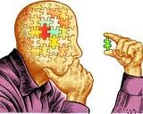
Reflective Practice
All 3 universities have used reflective diaries/reports as part of module assessment.
How often is this to be assessed? Weekly/twice a semester/end of semester?
How much ‘scaffolding’ do we give? None/weekly prompts/detailed questions?
What do we assess? Group skills/subject knowledge/ capacity to cope with change/ capacity to continue to learn?
In Manchester, the 5 reflective log assessment criteria are:
Completeness and presentation of report and quality of reflective practice
Demonstrating comprehension of underlying learning points
Demonstrating development of self-directed learning skills (analysing problems, researching literature, evaluating sources, critical appraisal of information, accurate referencing)
Awareness of and contribution to development of the team dynamics
Awareness and development of effective team processes

Slide 19
Peer Assessment
What is your experience of reflective practice and peer assessment?
Peer assessment is the assessment of student work by other students.
Benefits?
Helps students learn to evaluate their own learning
Encourages students to engage with assessment criteria
Gives students a sense of ownership of the assessment process
Encourages students to be more involved in group work and take more responsibility for their learning
Differentiates student marks
Draw-backs?
Software – WebPA, make your own system?
What to assess and how to assess it?
How does peer assessment relate to the learning outcomes?

Slide 20
Example Peer Assessment Criteria
Attended regularly and on time
Contributed actively to group discussions
Gathered appropriate ideas and information
Helped to shape ideas and analyse information to develop an appropriate solution
Helped the group to reach decisions by summarising ideas and information
Contributed to the structure and design of coursework
Contributed to the writing of coursework
Helped to keep the group focussed on the task
Made sure the views of everyone were included
Helped to identify and resolve potential conflicts in the group

Slide 21
4) Coping With Diversity
What are the differences within the group?
Diverse cultures
Diverse disciplines
Differences in learning style
Differences in language skill
Differences in expectations of group work
What are the differences in approach with PBL?
Differences in approach to learning
Differences in assessment
Dealing with expectations of ‘being taught’

Slide 22
Key Stats From Project – 2012 Modules – Keele, Manchester And Staffordshire Averages
Skills - % of students that said skills had ‘improved’ or ‘improved greatly’
Working in a team on a group task – 88%
Problem solving when presented with a task – 84%
Listening to others opinions and respecting people’s differences during group work – 78%
Effective discussion and negotiation within a team – 85%
Communicating your point of view to a wider audience, e.g. oral presentations – 71%
Communicating/working with others using online technology – 70%
Reflecting on what you have learnt and applying new knowledge and skills to other situations – 78%
Employability - Do you feel that you have gained any skills as a result of this module that will improve your chances of getting a job or enhance your performance at work, now or in the future? – 81% said yes
Group Working - Did you enjoy working in a group – 80% said yes
ESD – 65% of students said their attitude towards sustainability issues had changed ‘a lot’ or ‘a great deal’, 70% said their sustainability understanding and knowledge had increased ‘a lot’ or ‘a great deal’

Slide 23
Hybrid-PBL: Getting to Grips
Thank you for listening.
Any more questions?

